Slide 1
Audio Harmonizer
Annie Rizvi
Nina Rao
Jason Dimelow
Urinrinoghene Lauretta Omughelli

Slide 2
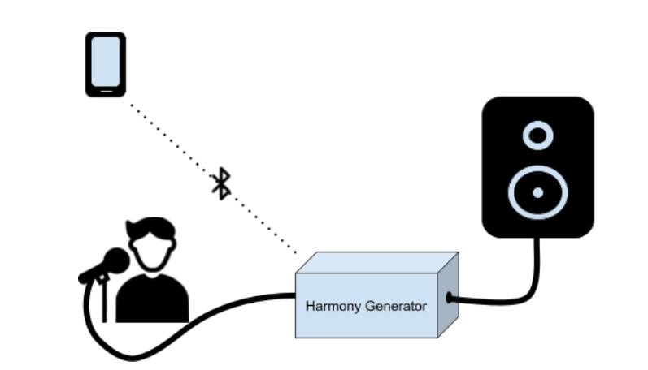
Project Statement
Create a system that allows artists to create multiple harmonies in real time for performances.
Notes:
Jason

Slide 3
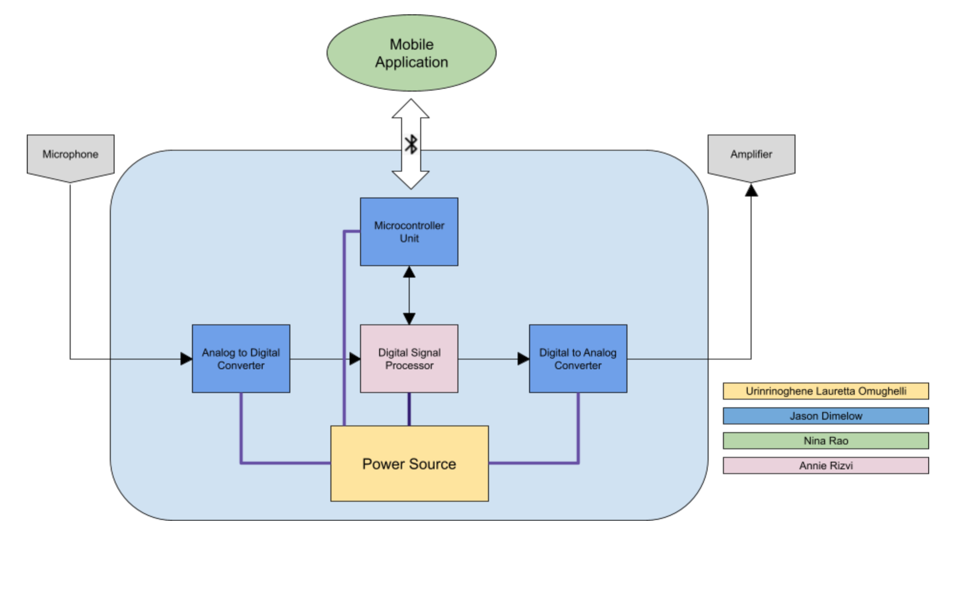
Project Subsystems
Notes:
Nina:

Slide 4
Major Changes
DSP Hardware Switched to Real Time MCU
No recording option due to time constraints
Originally an optional addition

Slide 5
Project Current Timeline
Integrating DSP Algorithms on to Real-Time MCU with Audio Booster Pack
MCU and Android Application Bluetooth Communication
Power PCB Order

Slide 6
Subsystems

Slide 7
Subsystem 1: Digital Signal Processor
Accomplishments Since 403 <20 hrs> | Ongoing progress/problems and plans until next presentation
Chose replacement Real-Time MCU for DSP subsystem | Running TI Sample Project Refactoring Sample Project for Harmonizing Algorithms Receive user input from MCU

Slide 8
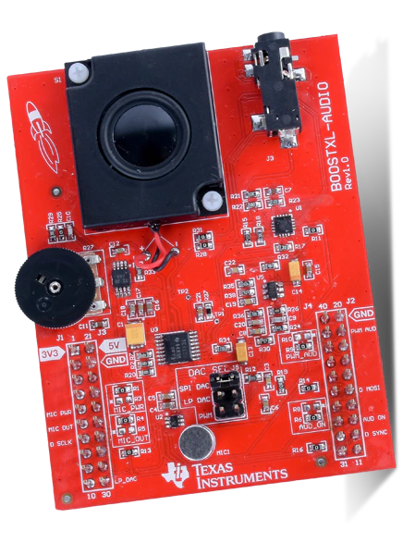
Digital Signal Processor
MSP430 Real-Time MCU with BOOSTXL-AUDIO Pack
TI Sample Project
Records for 3 seconds, plays for 3 seconds
Refactor to play and record in real time (with slight delay)
Insert algorithms from ECEN 403
Set up code to take user input from MCU

Slide 9
Subsystem 2: Microcontroller Unit
Accomplishments Since 403 <30 hrs> | Ongoing progress/problems and plans
MCU Testing from last semester complete In process of Bluetooth integration | Communication with App via bluetooth Communication with Battery Fuel Gauge Communication with DSP
Notes:
MCU will be relaying data to and fro the dsp/user interface via bluetooth. Telling the DSP what type of harmony the user wants, and then sending the digital to back to the app...

Slide 10
Subsystem 3: Converters/Main Unit Schematic
Accomplishments Since 403 <5 Hrs> | Ongoing progress/problems and plans until next presentation
Have a physical PCB design from last semester that is now impractical for our use | Waiting for DSP hardware testing and selection to finish PCB manufacturing for DSP/MCU PCB unit
Notes:
24 bits is the optimal bitrate as 32 is unnecessary, 48kHz for HiFi audio, minimum is 40kHz for good audio quality

Slide 11
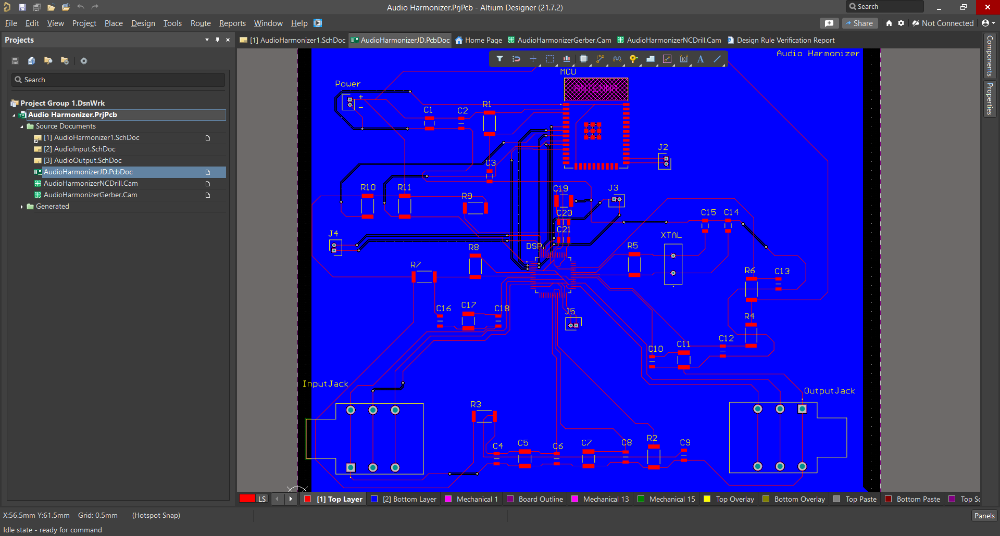

Slide 12
Subsystem 4: Android Application
Accomplishments Since 403 <10 hrs> | Ongoing progress/problems and plans until next presentation
Application is ready to send data from automatic and manual mode Able to pair application to the ESP32 | Connect Android and ESP32 to send data

Slide 13
Subsystem 5: Power Supply
Urinrinoghene Lauretta Omughelli
Accomplishments Since 403 <60 hrs> | Ongoing progress/problems and plans until next presentation
Designed battery charger, fuel gauge and converter IC breakout boards for perf board testing Test and validation Modified schematic to fix low/unstable output voltage Completed PCB design revision | I2C programming of fuel gauge IC Test PCB and check output voltage

Slide 14
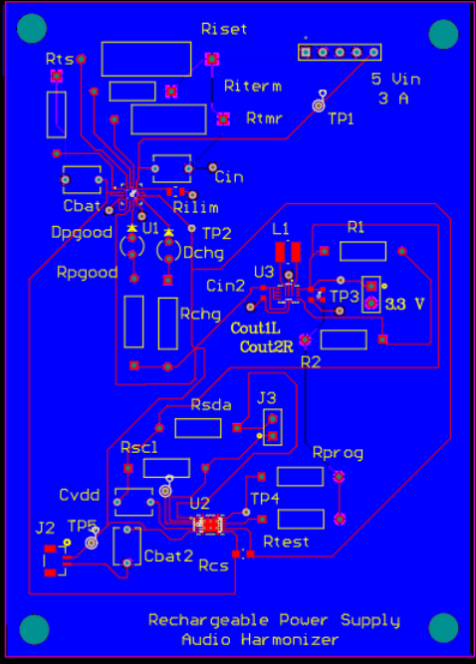
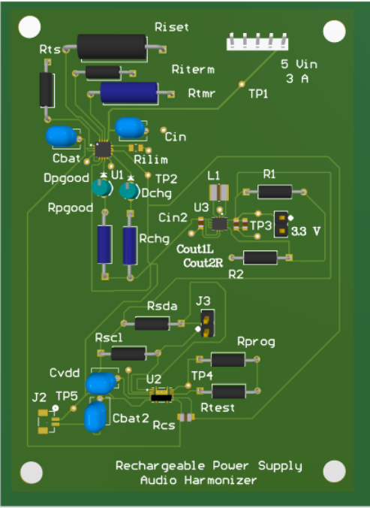
Power Supply
Urinrinoghene Lauretta omughelli
What currently works (On Perf board)?
-Battery charger IC charges battery
-Converter input voltage correctly switches between charger IC and battery
-Constant current when battery is charging
What doesn’t work?
-Low/unstable output voltage at buck-boost converter
What is changing?
- 1 buck boost converter
Updated PCB Design

Slide 15
Progress

Slide 16
Parts Ordering Status
All parts necessary for Power already ordered and received
Power PCB Ordered
MCU and DSP Ordered
Order ADC/DAC that match TI DSP Launchpad
Main PCB (MCU, DSP, ADC/DAC) will be ordered by next update

Slide 17
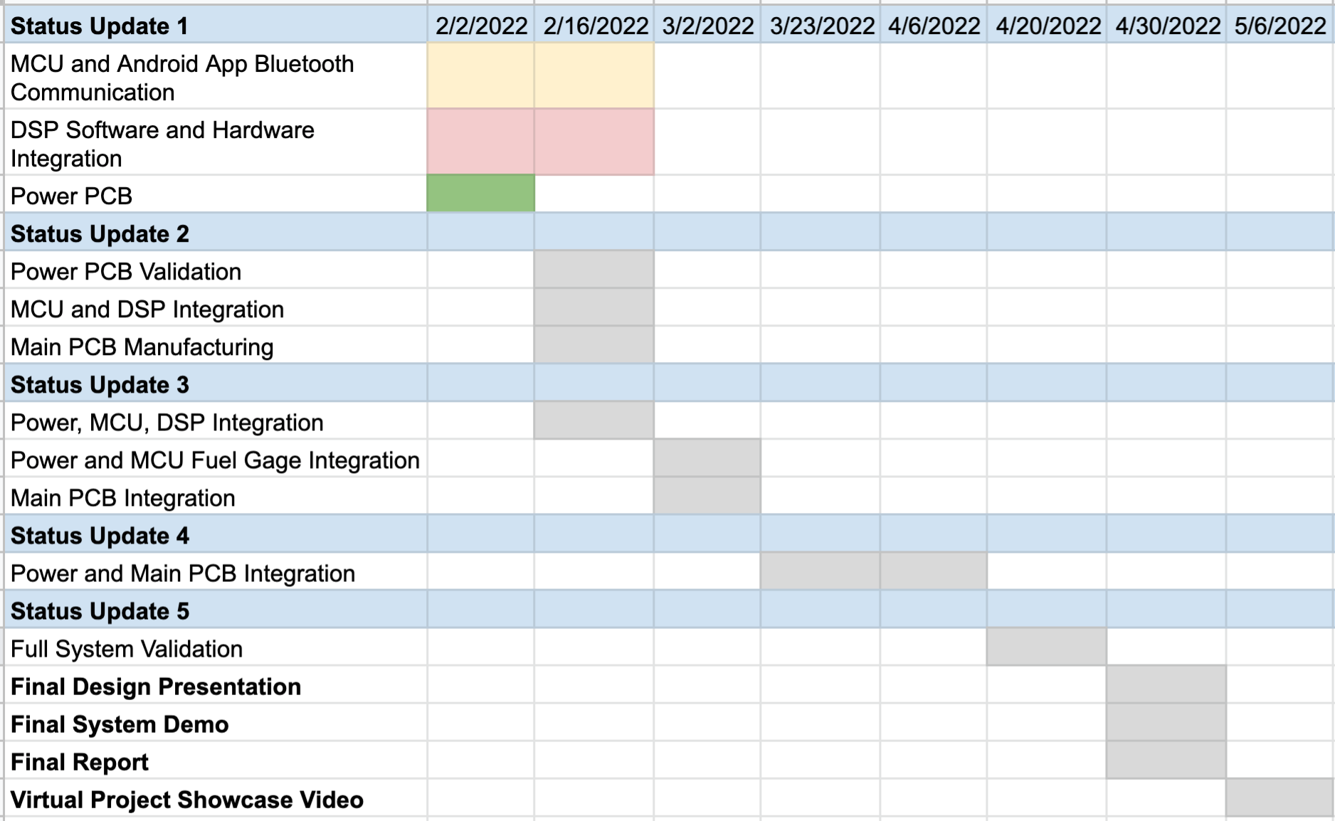
Execution Plan

Slide 18
Validation Plan
Test Name | Success Criteria | Methodology | Status | Responsible Engineers
MCU, Android App Bluetooth Communication | Android able to successfully send the mode, number of harmonies and additional necessary information to ESP32 MCU which is visible and interpretable by the ESP32 terminal | App connects via bluetooth and sends sample user data | Ongoing | Nina Rao, Jason Dimelow
DSP with ADC/DAC Hardware Integration | Able to receive sample audio in real time and harmonize with specific chord progression which is output through DAC | Use TI Real time MCU Launchpad and Audio Booster Pack | Ongoing | Annie Rizvi
DSP and MCU Communication | DSP receives fake user input from MCU via input pins and is interpretable | Use ESP32 and TI MCU Launchpad LEDs to verify input | To Do | Annie Rizvi, Jason Dimelow
Fuel Gage, MCU, Android App Communication | Android App displays battery voltage and state of charge. | Programming of the MCU to communicate with the fuel guage through I2C | To Do | Lauretta Omughelli, Jason Dimelow
Android, MCU, DSP Seamless Communication | User inputs values via application which is sent through MCU to DSP to run correct harmonizing algorithm in real time | Use Ti Real time MCU Launchpad and Audio Booster Pack connected to ESP32 | To Do | Nina Rao, Jason Dimelow, Annie Rizvi
Input Voltage for Subsystems | All subsystems properly powered through rechargeable battery | Use voltmeter to ensure voltage values match requirements | Ongoing | Lauretta Omughelli
Full System Functionality | User able to use Audio Harmonizer that is powered by rechargeable battery for real time harmonization | Team member pretends to be user with instrument or singing into mic connected to Audio Harmonizer, using App on Android Phone | To Do | Nina Rao, Jason Dimelow, Lauretta Omughelli, Annie Rizvi

Slide 19
Questions?

